Slide 1

Subscribe to DeepL Pro to edit this document.
Visit www.DeepL.com/pro for more information.

Slide 2
Faculty of Computer Science Educational program "Software Engineering"
Graduation qualification work
WEB APPLICATION FOR ORGANIZING AND MANAGING HACKATHON TEAMS "HACKSYNC" WEB APPLICATION FOR ORGANIZING AND MANAGING HACKATHON TEAMS "HACKSYNC"
Project WRC
Performed by a student of group BPI217
educational program
09.03.04 "Software Engineering"
Afonin Alexander Sergeevich
Supervisor:
Lecturer of the Software Engineering Department
Matvey Vladislavovich Morgen
Moscow, 2024

Slide 3
BASIC CONCEPTS, DEFINITIONS, TERMS
A hackathon is an event where teams prototype solutions in a limited amount of time (24-72 hours, rarely a week to a month).
A project is a solution to a task set by the hackathon organizers and worked on by a team.
Team member - in the context of this project: a member of some team that participates in hackathons (it can be active in a hackathon if it participates, and inactive otherwise).
A team captain is a team member who is responsible for - adding new participants, - recruitment of active team members for the hackathon from the general team.

Slide 4
DESCRIPTION OF THE SUBJECT AREA AND PROBLEM
The subject area is the organization and management of teamwork and communication within the team at hackathons. At the moment there are few solutions that centrally implement the functionality required for effective team management and communication at hackathons.
photo
! WARNING !
Use no more than 3 colors and no more than 3 fonts on a single slide.
The font sizes are roughly the same throughout the presentation.
Code or pseudocode fragments - in monospaced font (e.g. Courier or Consolas)
photo
photo
Higher School of Economics, Moscow, 2020

Slide 5
WORK RELEVANCE
The development of a project management system for hackathons is relevant to increase productivity and quality of communication, which is important for successful realization of ideas.

Slide 6



CURRENT STATUS OF THE PROBLEM
Alternative approaches are available, but each has its own limitations. Among the analogs are universal project management systems such as Jira, Trello, and Asana, which can be partially adapted to hackathons. Their ease of use is inferior to my application, and the previously described tools, although extensible for my subject area, require customization or lack functionality.
Jira, (Atlassian, https://www.atlassian.com/ru/software/jira, 2002 release) is a professional project management system designed for development teams, with a focus on task tracking, managing sprints, and maintaining Agile processes.
Trello, (Atlassian, https://trello.com/, 2011 issue) is a simple task management tool based on kanban boards, convenient for visualizing and distributing work in teams.
Asana (Asana, Inc., https://asana.com/, 2012 release) is an all-in-one enterprise-focused project management platform with support for tasks, deadlines, and analytics.

Slide 7
ANALYSIS OF EXISTING SOLUTIONS
Use of specialized templates in existing tools
Use of physical kanban boards

Slide 8
ANALOGY ANALYSIS
Title | Team management | Kanban board | Chat for participants | Calendar | Project Management | Deadlines
Your application | ✅ | ✅ | ✅ | ✅ | ✅ | ✅
Trello | ❌ | ✅ | ❌ | ❌ | ❌ | ✅
Asana | ✅ | ✅ | ❌ | ✅ | ✅ | ✅
Jira | ✅ | ✅ | ❌ | ❌ | ✅ | ✅
Hackerearth | ✅ | ❌ | ❌ | ❌ | ✅ | ❌
Slack | ❌ | ❌ | ✅ | ❌ | ❌ | ❌
Discord | ❌ | ❌ | ✅ | ❌ | ❌ | ❌
Devpost | ✅ | ❌ | ❌ | ❌ | ✅ | ❌
Notion | ✅ | ✅ | ❌ | ✅ | ❌ | ✅

Slide 9
FUNCTIONAL REQUIREMENTS FOR THE PROGRAM
Authorization and user management
Project Management
Chats
Kanban board and tasks
Deadlines
Calendar
Integrations with external systems

Slide 10
AIM AND OBJECTIVES OF THE WKR
Purpose of work Create a specialized web application that integrates all the necessary functionality to organize and manage hackathon participants.
Objectives of the work
Requirements analysis
Description of interaction scenarios
System design at the levels of context, containers, components
Selection of methods, models, algorithms
Choice of means of implementation
Realization of functional requirements
Functional testing
Optimization and debugging
Development of program documentation

Slide 11
TECHNOLOGIES AND TOOLS FOR IMPLEMENTATION
Programming languages:
Java is the main development language of the server part
JavaScript (TypeScript) is the main development language of the client part
Development Environment:
IntelliJ IDEA is an IDE for Java development.
Visual Studio Code - for frontend work.
Version control system:
Github (GitHub, Inc., https://github.com/)

Slide 12
TECHNOLOGIES AND TOOLS FOR IMPLEMENTATION
Frameworks and libraries for the backend:
Spring Framework (Pivotal Software, v3.x, 2024, https://spring.io/projects/spring-boot)
Hibernate (Gavin King and the Hibernate team, v6.x, 2024, https://hibernate.org/orm/)
Resilience4j (Robert Winkler, v1.x, 2024, Robert Winkler)
Frameworks and libraries for backend testing:
JUnit (JUnit Team, v5.0, https://junit.org/)
Mockito (Mockito Team, v4.x, https://site.mockito.org/)
Database:
PostgreSQL (PostgreSQL, v16.x, 2024, https://www.postgresql.org/)

Slide 13
TECHNOLOGIES AND TOOLS FOR IMPLEMENTATION
Frontend technologies:
React (Meta Platforms, Inc., v18.x, 2024, https://react.dev/)
Tailwind CSS (Tailwind Labs, v3.x, 2024, https://tailwindcss.com/)
Redux (Dan Abramov, Andrew Clark, v4.x, 2024, https://redux.js.org/)
Frameworks and libraries for frontend testing:
Cypress (Cypress.io, v12.x, https://www.cypress.io/)

Slide 14
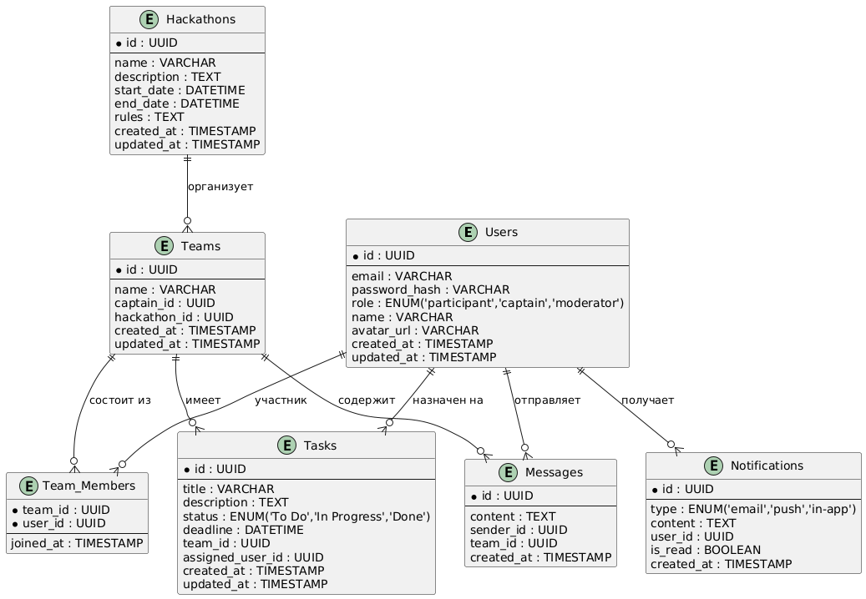
DATABASE SCHEMA

Slide 15
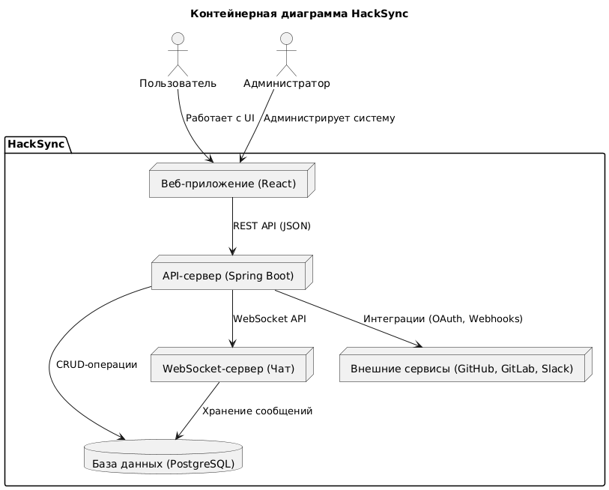
CONTAINER ARCHITECTURE

Slide 16
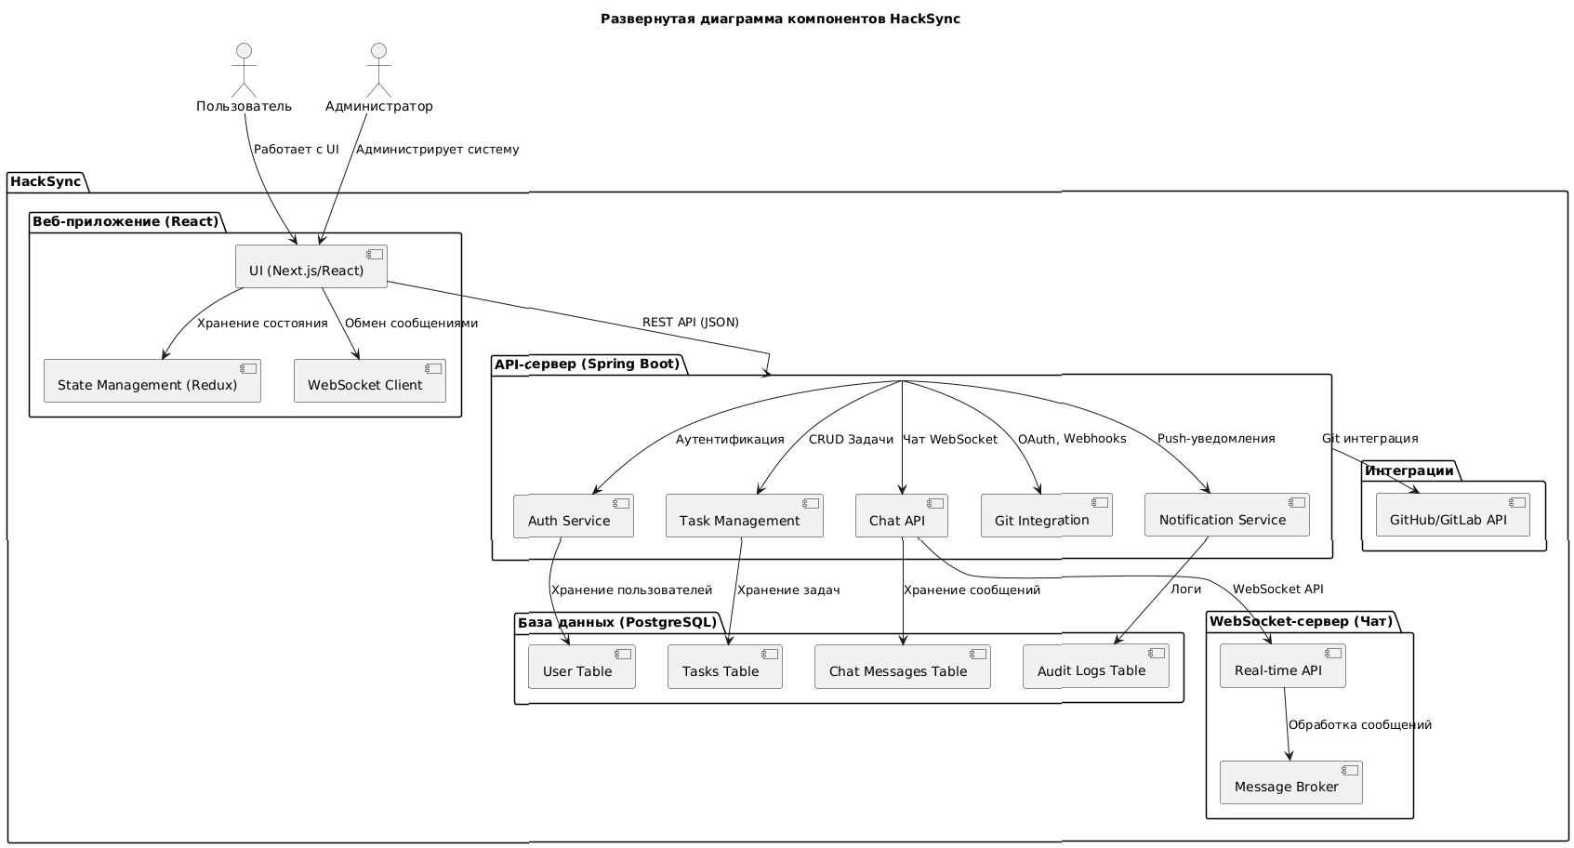
COMPONENT ARCHITECTURE

Slide 17
EXPECTED RESULTS
Requirements have been developed
The architecture of the system has been developed
Development tools were finally selected and analyzed
All functional requirements have been realized
Written auto-tests and performed manual testing
Program documentation has been developed

Slide 18
LIST OF SOURCES USED
Atlassian. Jira [Electronic resource]: project management system / Atlassian. - Electron. dan. - Access mode: https://www.atlassian.com/ru/software/jira, free. (date of reference: 20.11.2024).
Atlassian. Trello [Electronic resource]: a system for task management / Atlassian. - Electron. dan. - Access mode: https://trello.com/, free. (date of reference: 20.11.2024).
Asana, Inc. Asana [Electronic resource]: a platform for project management / Asana, Inc. - Electron. dan. - Access mode: https://asana.com/, free. (date of reference: 20.11.2024).
PostgreSQL Global Development Group. PostgreSQL [Electronic resource]: database / PostgreSQL Global Development Group. - Electron. dan. - Access mode: https://www.postgresql.org/, free. (date of address: 20.11.2024).
Docker, Inc. Docker [Electronic resource]: a tool for containerization / Docker, Inc. - Electron. dan. - Access mode: https://www.docker.com/, free. (date of reference: 20.11.2024).
Format in accordance with GOST (see Methodological guidelines for the design of the list of used sources).

Slide 19
LIST OF SOURCES USED
OpenAPI Initiative. Swagger/OpenAPI [Electronic resource]: API documentation tool / OpenAPI Initiative. - Electron. dat. - Access mode: https://swagger.io/, free. (date of reference: 20.11.2024).
JUnit Team. JUnit [Electronic resource]: library for testing / JUnit Team. - Electron. dan. - Access mode: https://junit.org/, free. (date of access: 20.11.2024).
Mockito Team. Mockito [Electronic resource]: library for creating mocks / Mockito Team. - Electron. dan. - Access mode: https://site.mockito.org/, free. (date of reference: 20.11.2024).
SeleniumHQ. Selenium [Electronic resource]: a tool for testing interfaces / SeleniumHQ. - Electron. dan. - Access mode: https://www.selenium.dev/, free. (date of reference: 20.11.2024).
Postman, Inc. Postman [Electronic resource]: API testing tool / Postman, Inc. - Electron. dan. - Access mode: https://www.postman.com/, free. (date of access: 20.11.2024).
Format in accordance with GOST (see Methodological guidelines for the design of the list of used sources).

